Slide 1

ASEN 5070
Statistical Orbit determination I
Fall 2012
Professor George H. Born
Professor Jeffrey S. Parker
Lecture 4: Coding and Linear Algebra Review

Slide 2
Announcements
Homework 1 due today
Homework 2 due in 7 days
I will most likely not be available during my Monday office hours. Definitely use the TAs – I hear they’re bored.

Slide 3
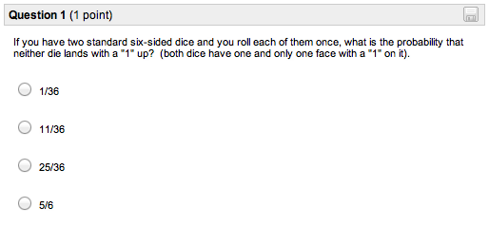
Quiz Results

Slide 4
Quiz Results

Slide 5
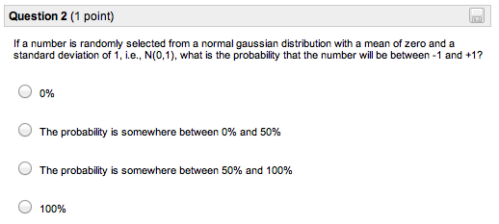
Quiz Results

Slide 6
Quiz Results

Slide 7
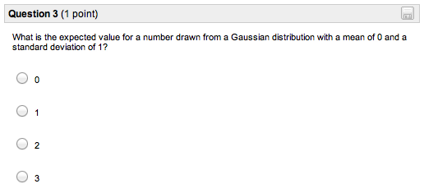
Quiz Results

Slide 8
Quiz Results

Slide 9
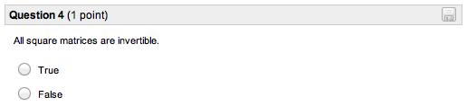
Quiz Results

Slide 10
Quiz Results

Slide 11
Today’s Lecture
Coding hints and tricks
MATLAB: ways to speed up your code
Python: intro
Review of Linear Algebra
Review of Statistics Tuesday

Slide 12
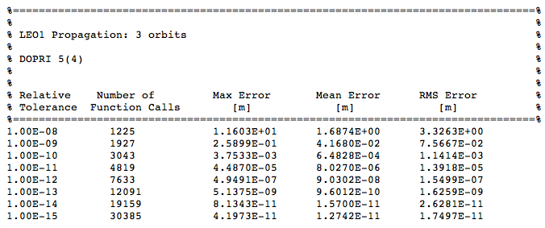
First: 1 slide on integration tolerances
ode45’s default tolerance: 1e-6
What should you set it to be?

Slide 13

Matlab Overview

Slide 14
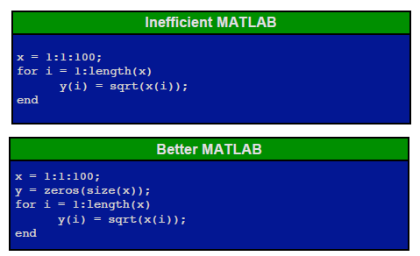
Generic Tips: Pre-allocate

Slide 15
Generic Tips: Misc.
Learn to use help function/online resources
% Comment your code!!!
Name functions and outputs descriptively

Slide 16
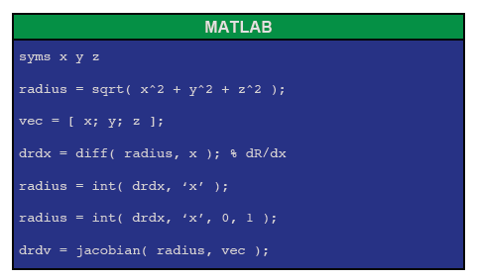
Symbolic Toolbox

Slide 17
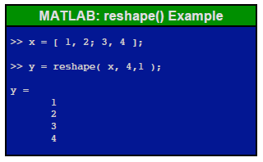
reshape() Command
Use to convert STM from matrix to a vector so it can be numerically integrated

Slide 18

Python
Python is a free, open source programming language that runs on nearly everything.
Resources:
http://www.python.org/
Python 3 Tutorial: http://docs.python.org/py3k/tutorial/
IDEs:
Xcode
Emacs / xemacs / vi

Slide 19
Python
Python is high-level
No memory management requirements by the user. Hurrah!
Python is object oriented.
Matlab is a little, but Python is a lot.
Python can do anything that Matlab can do, but differently.
Some things are easier, some harder.

Slide 20
Python
Working on some example tutorials that parallel the Matlab tutorials.

Slide 21
Questions
Questions on Coding?
Quick Break
Next topics:
Review of Linear Algebra
Review of Statistics

Slide 22

Notation

Slide 23
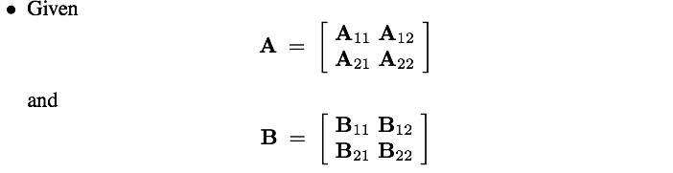
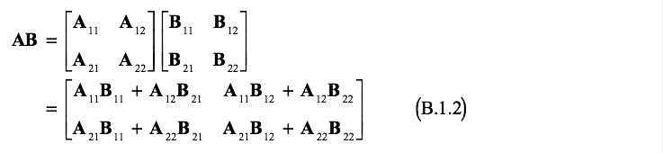
Matrix Multiplication

Slide 24
Fundamentals

Slide 25

Fundamentals

Slide 26
Matrix Rank

Slide 27
Matrix Rank
Example: What is the rank of the following matrices?

Slide 28

Matrix Rank

Slide 29
Quadratic Forms

Slide 30
Quadratic Forms

Slide 31

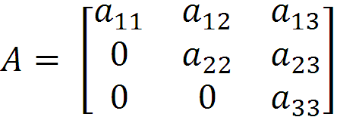
Triangle Matrices

Slide 32





Matrix Square Root

Slide 33

Determinants

Slide 34
Determinants

Slide 35
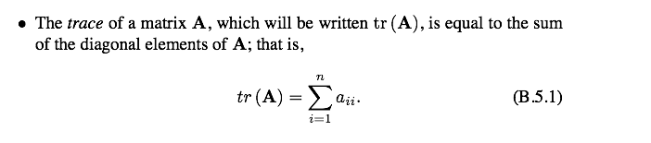

Matrix Trace

Slide 36


Eigenvalues and Eigenvectors

Slide 37

Eigenvalues and Eigenvectors

Slide 38
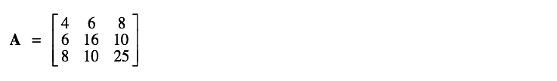

Eigenvalues and Eigenvectors
Example:

Slide 39



Derivatives

Slide 40
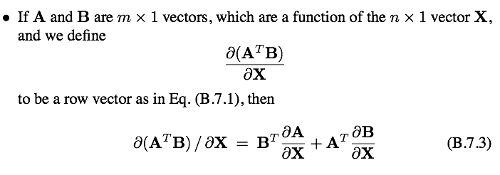

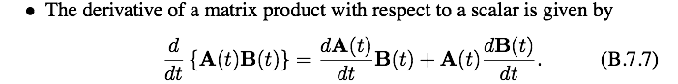
Derivatives

Slide 41



Maxima and Minima

Slide 42
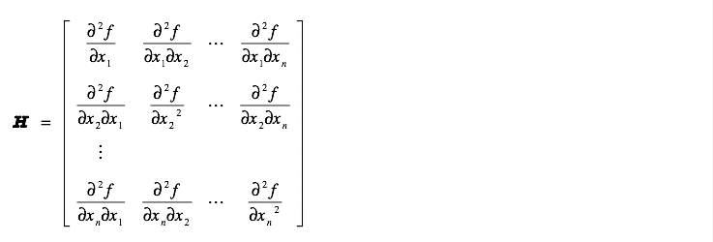
Maxima and Minima

Slide 43
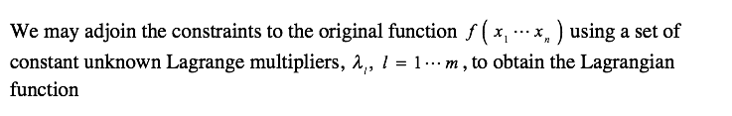

Maxima and Minima

Slide 44

Maxima and Minima

Slide 45
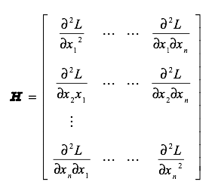
Maxima and Minima

Slide 46
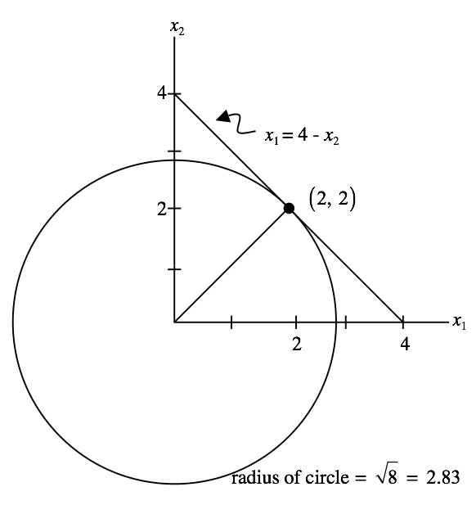

Maxima and Minima
Example:

Slide 47
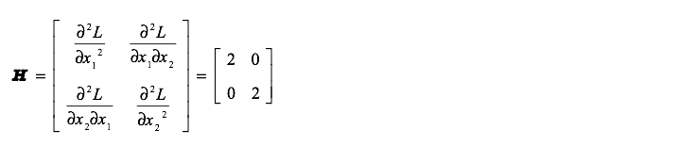
Maxima and Minima
Example:

Slide 48
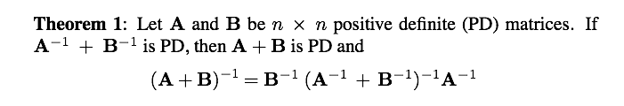
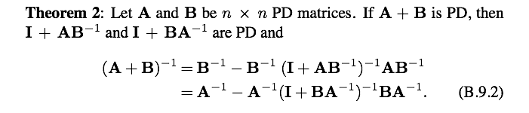
Matrix Inversion Theorems

Slide 49
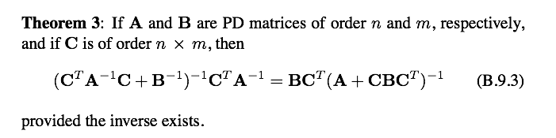

Matrix Inversion Theorems

Slide 50
Final Thoughts
Homework 1 due today
Homework 2 due in 7 days
Next quiz active Monday at 1pm.

